Slide 1

RISK AND RESILIENCE BOOTCAMP
6

Slide 2
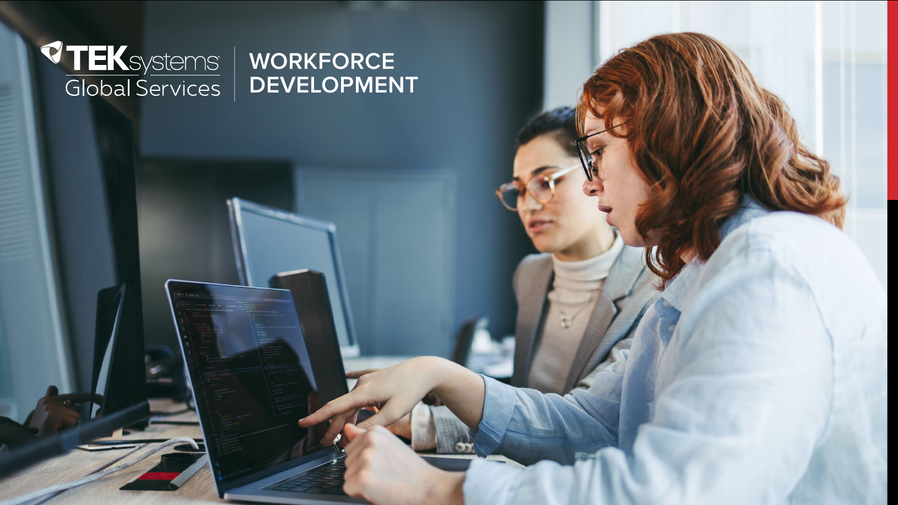

Slide 3

Cloud Computing
This section is an introduction to cloud computing systems
What they are
The IT challenge of cloud computing
The risk and resilience issues associated with cloud computing

Slide 4
Cloud Computing
History and evolution
Early roots: virtualization and grid computing in the 2000s
Amazon launched EC2 in 2006: commonly cited as birth of modern public IaaS
Allowed the use of virtualized infrastructure like disks, servers (recall this from a previous module)
Growth of PaaS, serverless, containers, Kubernetes, microservices
Allowed for the deployment of operational environments without a virtual infrastructure
Increasing focus on AI/ML services, data lakes, managed services
Adoption
The initial wave of migration to the cloud was motivated by cost
Instead of capital investment in hardware, the infrastructure was leased in the cloud
Modern trend is to re-host cloud applications on site
The declining cost of hardware and changed the ROI equation

Slide 5
Service models
IaaS (Infrastructure as a Service)
Virtual machines, storage, networking
Customer controls OS, middleware, applications
PaaS (Platform as a Service)
Managed runtime, middleware, development frameworks
Infrastructure is opaque to the users
SaaS (Software as a Service):
Fully managed applications like CRM, email, and ERP
FaaS / Serverless
Event-driven, function-execution abstraction
Other models:
DBaaS, CaaS: Database as a service, containers as a service, etc.

Slide 6
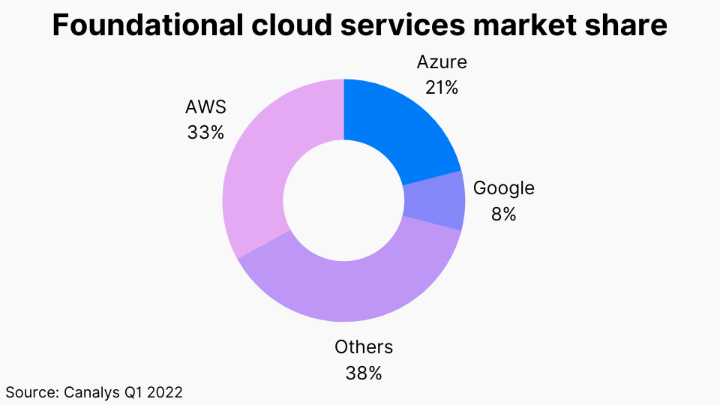
vendors
Amazon Web Services (AWS)
Microsoft Azure
Google Cloud Platform (GCP)
Others / regional players (Alibaba, IBM Cloud, Oracle Cloud, etc.)

Slide 7
Cloud Deployment Models
Public cloud
Operated by a third-party provider that offers computing resources (servers, storage, databases, networking, software) over the internet to multiple customers on a pay-as-you-go basis
Characteristics
Shared infrastructure (multi-tenant environment)
On-demand self-service and elasticity
Highly scalable and globally distributed
Provider responsible for physical and infrastructure security
Customer responsible for workloads, configurations, and access (per shared responsibility model)

Slide 8
Cloud Deployment Models
Public cloud
Common use cases
Web hosting and APIs
Data analytics and machine learning
Development and testing environments
Backup and disaster recovery
Fintech and digital banking front-end services
Risk considerations
Data security and privacy (multi-tenancy and jurisdiction issues)
Compliance and data residency constraints in financial and government sectors
Vendor lock-in risk due to proprietary APIs and services
Resilience impact
High resilience due to redundant data centers, availability zones, and automated recovery
However, customers depend on the provider’s uptime and region architecture
Overreliance on one cloud provider can create concentration risk

Slide 9
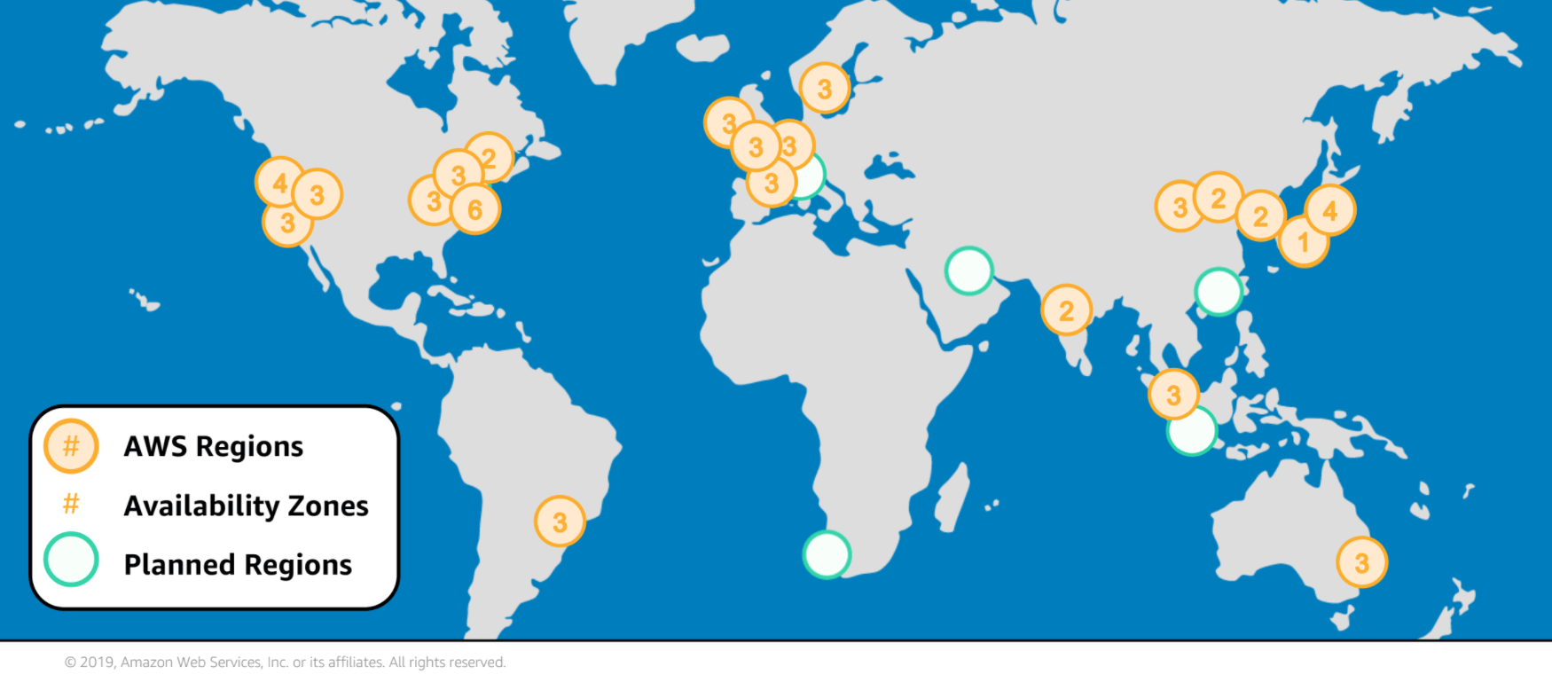
Cloud Deployment Models

Slide 10
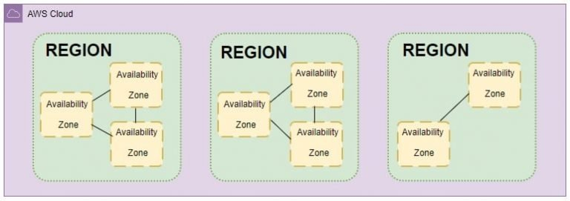
Cloud Deployment Models

Slide 11
Cloud Deployment Models
Private cloud
Infrastructure operated solely for one organization, hosted either on-premises or by a third-party provider.
It offers many of the benefits of cloud computing (virtualization, elasticity, self-service) but within a controlled, dedicated environment
Examples
VMware vCloud Suite
OpenStack private clouds
Red Hat OpenShift (for container-based private clouds)
IBM Cloud Private
Characteristics
Single-tenant (exclusive resources)
Customizable for specific security, governance, or compliance requirements
Often managed internally or through a managed service provider (MSP)
Can integrate with existing legacy systems

Slide 12
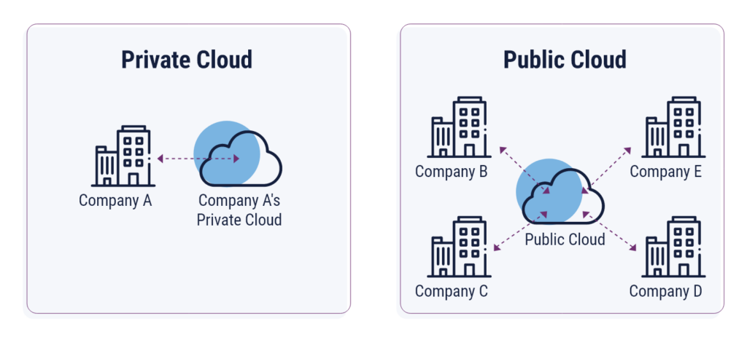
Cloud Deployment Models

Slide 13
Cloud Deployment Models
Private cloud
Common use cases
Core banking systems
Payment processing and transaction settlement systems
Sensitive healthcare or government data handling
Critical workloads that must meet strict regulatory controls
Risk considerations
High capital and operational costs (infrastructure ownership)
Limited elasticity compared to public cloud
Internal management risk: resilience depends on in-house expertise and redundancy of the design
Resilience impact
Full control over security, recovery, and redundancy planning
Strong isolation reduces exposure to shared infrastructure threats
Resilience depends entirely on internal design: if redundancy is underfunded, the system remains fragile

Slide 14
Cloud Deployment Models
Hybrid cloud
A computing environment that combines public and private clouds, allowing data and applications to move between them
It integrates on-premises or private resources with public cloud services for flexibility, scalability, and compliance control
Examples
Azure Arc, AWS Outposts, Google Anthos (hybrid orchestration tools)
Characteristics
Enables “best of both worlds”: control and security for sensitive workloads, scalability for others
Connectivity between environments via VPNs, private links, or dedicated interconnects
Supports bursting (overflowing workloads to public cloud during demand spikes)
Common use cases
Banks running transaction systems on private infrastructure while using public cloud for analytics or mobile apps
Governments keeping citizen identity databases on-prem while hosting e-services in public clouds
Disaster recovery and backup in public cloud while operations continue on private infrastructure

Slide 15
Cloud Deployment Models
Hybrid Cloud
Risk considerations
Integration and interoperability risks between environments
Complex security and identity management
Data movement risks and potential misconfiguration between cloud boundaries
Resilience impact
Increased resilience through multiple failover options and flexible recovery paths
Complexity of integration can introduce operational fragility if not managed carefully
Requires strong orchestration, monitoring, and consistent policies across environments

Slide 16
Cloud Deployment Models
Community cloud
A collaborative cloud infrastructure shared by several organizations with common goals, compliance requirements, or interests
Ownership may be collective or managed by a third-party provider.
Examples
Government agencies sharing a cloud platform for national services
A consortium of banks using a jointly managed secure cloud (e.g., IBM Cloud for Financial Services)
Healthcare networks pooling cloud infrastructure compliant with HIPAA
Characteristics
Shared governance model
Customized compliance and security controls relevant to the community
Cost shared among participants
May be hosted on dedicated infrastructure or managed by a trusted third party

Slide 17
Cloud Deployment Models
Community cloud
Common use cases
Government ministries sharing infrastructure for e-services
Financial consortiums for payment clearing or data exchange
Research collaborations between universities
Risk considerations
Governance complexity because of shared responsibility and decision-making
Data segregation and confidentiality among tenants
Dependency on central management or service providers
Resilience impact
Pooled resources can increase redundancy and load distribution
Governance delays can hinder incident response
Shared operational standards can strengthen collective resilience if coordinated well

Slide 18
Cloud Deployment Models
Multi-cloud
Use of two or more public cloud providers (e.g., AWS + Azure + GCP) for different workloads or redundancy
A multi-cloud strategy avoids dependence on a single provider and can leverage unique capabilities from each vendor
Characteristics:
Distribution of workloads across multiple clouds
Common tools or orchestration layers manage deployment and monitoring
For example: Terraform, Kubernetes, HashiCorp Consul
Data replication or workload failover across clouds
Policy-driven workload placement for performance or compliance

Slide 19
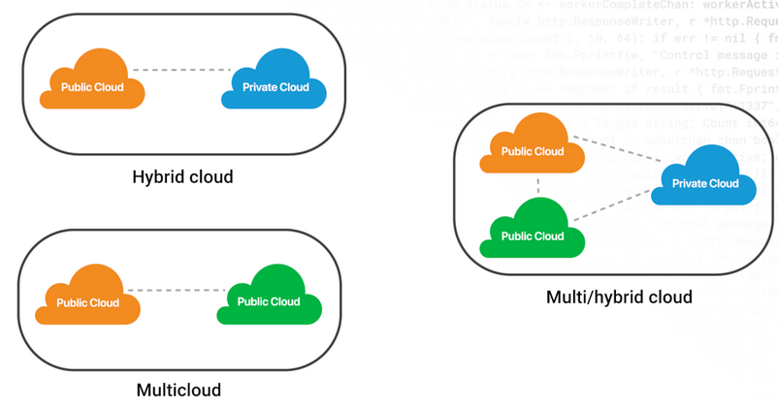
Cloud Deployment Models

Slide 20
Cloud Deployment Models
Multi-cloud
Common use cases
Banks or governments ensuring critical workloads can continue even if one provider experiences an outage
Enterprises adopting best-of-breed services (e.g., AI from Google, databases from AWS)
Businesses managing global operations with provider-specific regional advantages
Risk considerations
Operational complexity: managing APIs, security, and monitoring across vendors
Cost overhead due to redundant services and data transfer
Data consistency and latency issues between providers
Resilience impact
Strong protection against single-provider failure (reduces concentration risk)
Enables flexible disaster recovery and vendor diversification
Complexity can reduce manageability: resilience only improves if properly designed and tested

Slide 21
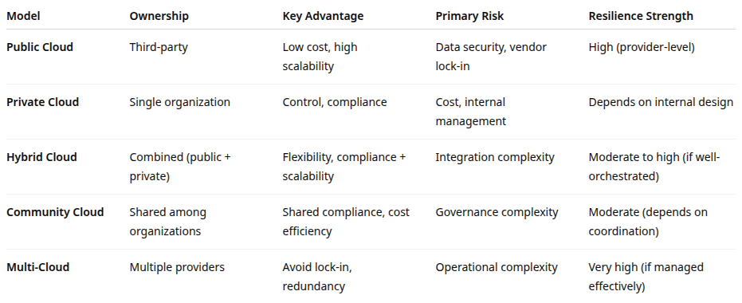
Cloud Deployment Models

Slide 22
Core Technologies & Concepts
Virtualization and hypervisors
Virtualization allows multiple virtual machines (VMs) to run on a single physical server by abstracting hardware resources (CPU, memory, storage, and network)
A hypervisor is the software layer that manages this abstraction
Common hypervisors
Xen: used by AWS and others
KVM (Kernel-based Virtual Machine): Open source, used by Google Cloud
Hyper-V: Microsoft’s hypervisor for Azure and Windows Server environments
VMware ESXi: Widely used in enterprise private clouds
How it works
The hypervisor partitions physical resources into multiple isolated “guest” systems
Each virtual machine acts like an independent computer, running its own operating system and applications

Slide 23
Core Technologies & Concepts
Virtualization and hypervisors
Resilience benefits
Enables resource pooling and fault isolation: one VM crash doesn’t affect others
Supports live migration: VMs can be moved between hosts during maintenance or failure
Simplifies disaster recovery and backup: VMs can be snapshotted and restored quickly
Risk considerations
Hypervisor vulnerabilities can compromise all VMs on a host
Noisy neighbor effects: one tenant consuming excessive resources can affect others.
Complex management: VM sprawl and patching issues if governance is weak.

Slide 24
Core Technologies & Concepts
Containers and orchestration
Containers are lightweight, portable units that package applications with their dependencies, sharing the host OS kernel
They start faster and use fewer resources than VMs
Common tools
Docker: containerization platform
Kubernetes (K8s): orchestration system for managing containers at scale
Podman, OpenShift, Amazon ECS/EKS, Google GKE, Azure AKS: cloud-native container orchestration services.
How it works
Containers isolate application processes in lightweight independent processes
Orchestration tools manage deployment, scaling, failover, and networking of containers across multiple hosts

Slide 25
Core Technologies & Concepts
Containers and orchestration
Resilience benefits:
Rapid recovery: failed containers can be automatically restarted or rescheduled
Scalability: workloads can scale horizontally based on demand
Microservice isolation: faults in one service don’t crash the whole application
Portability: easy migration across environments (dev, test, production)
Risk considerations:
Configuration drift and weak isolation if mismanaged
Security of container images: vulnerable base images or misconfigured registries
Complexity: orchestrators like Kubernetes introduce new attack surfaces and require careful monitoring

Slide 26
Core Technologies & Concepts
Virtual networking
Separates the control plane (decision-making about where traffic goes) from the data plane (actual traffic forwarding)
This allows network configuration to be automated through software rather than manual hardware changes
Uses
Enables virtual private clouds (VPCs) and subnets
Provides programmable firewalls, load balancers, and routing rules
Allows dynamic traffic rerouting and segmentation across tenants
Resilience benefits
Enables rapid recovery from network failures via automated rerouting
Supports isolation between workloads, improving security and fault containment
Allows for multi-region connectivity and seamless scaling
Risk considerations
Misconfigurations can expose entire networks
Centralized controllers can become single points of failure
Complex visibility: attacks or faults can propagate quickly in virtualized networks if not monitored

Slide 27
Core Technologies & Concepts
Object and block storage services, distributed file systems
Cloud storage systems abstract physical storage into logical pools that can be accessed over networks
Types
Block Storage: low-level data storage used by VMs: e.g., Amazon EBS, Azure Disks
Object Storage: stores unstructured data as objects in buckets: e.g., Amazon S3, Azure Blob Storage, Google Cloud Storage
Distributed File Systems: file-based access across multiple nodes: e.g., Google File System, Ceph, Lustre
Resilience benefits
High durability: data replicated across multiple availability zones or regions
Versioning & snapshot features: rapid recovery from corruption or accidental deletion
Elastic capacity: scales automatically as data grows
Risk considerations
Access misconfigurations (e.g., public S3 buckets) are a major data breach source
Eventual consistency: updates may not immediately propagate globally
Latency or regional outages can affect dependent services

Slide 28
Core Technologies & Concepts
Load balancers, auto-scaling, and elasticity
Load balancers distribute incoming traffic across multiple servers or instances to ensure availability and responsiveness
Auto-scaling adjusts computing capacity automatically based on demand.
Examples
Elastic Load Balancer (AWS), Azure Load Balancer, Google Cloud Load Balancer
Auto-scaling Groups (ASGs), Horizontal Pod Autoscaler (Kubernetes)
Resilience benefits
Prevents overload of individual nodes: avoids single points of failure
Auto-scaling ensures service continuity during traffic spikes
Improves fault tolerance by rerouting traffic to healthy instances
Risk considerations
Misconfigured scaling policies can cause cost overruns or instability loops
Load balancer failure can disrupt entire service access
Monitoring and policy testing are critical for predictable behavior

Slide 29
Core Technologies & Concepts
Regions, availability zones, and edge locations
Cloud providers organize their infrastructure geographically for performance, compliance, and resilience
Region: a physical area (e.g., “US-East-1”) containing multiple data centers
Availability Zone (AZ): independent data centers within a region, isolated by power, cooling, and network
Edge Location: smaller, distributed sites closer to end-users for caching and low-latency access (used by CDNs and edge computing)
Resilience benefits
Redundancy: replication across AZs mitigates hardware or power failures
Disaster recovery: regional replication supports continuity after catastrophic events
Latency optimization: edge locations improve responsiveness and user experience
Risk considerations
Region-level outages still occur (e.g., AWS US-East-1)
Data residency issues arise from cross-region replication
Overconfidence in “region redundancy” can lead to hidden concentration risk

Slide 30
Core Technologies & Concepts
Serverless and event-driven architectures
Serverless computing allows developers to run code without managing servers
The cloud provider handles scaling, provisioning, and availability
Event-driven systems respond automatically to triggers like API calls, file uploads, or messages
Examples
AWS Lambda, Azure Functions, Google Cloud Functions
Event buses: Amazon EventBridge, Kafka, Pub/Sub
Resilience benefits
Automatic scaling and failover: no idle capacity or manual provisioning
Fine-grained recovery: only affected functions restart on error
Operational simplicity: less infrastructure to patch or monitor
Risk considerations
Cold start latency: delay when functions scale up
Limited observability in complex workflows
Vendor lock-in: heavy dependence on proprietary runtime services
Hidden dependencies: chained serverless functions can fail in unpredictable ways

Slide 31
Core Technologies & Concepts
Managed services (databases, queues, AI, analytics)
Managed services are pre-built components operated by the provider
Customers consume functionality (e.g., database, analytics, AI) without managing the underlying infrastructure
Examples
Databases: Amazon RDS, Azure SQL Database, Google Cloud Spanner
Message Queues: Amazon SQS, Azure Service Bus, Kafka on Confluent Cloud
AI/ML: AWS SageMaker, Azure Cognitive Services, Google Vertex AI
Analytics: BigQuery, Redshift, Snowflake, Databricks
Resilience benefits
Providers handle replication, backups, patching, and scaling
Built-in multi-AZ redundancy and automated failover
Allows focus on business logic instead of infrastructure
Risk considerations
Vendor dependency and interoperability risks (e.g., proprietary databases)
Opaque control: customers rely on provider’s DR and maintenance policies
Complex failure modes: cascading effects when managed dependencies fail

Slide 32
Core Technologies & Concepts
Service meshes, API gateways, and microservices architectures
Modern cloud-native systems decompose applications into microservices that communicate via APIs
A service mesh manages service-to-service communication, while API gateways expose services securely to clients
Key technologies
Service Mesh: Istio, Linkerd, Consul Connect
API Gateways: Kong, Apigee, AWS API Gateway, Azure API Management
Resilience benefits
Fault isolation: failure in one microservice doesn’t crash the entire system
Traffic control: routing, retries, and circuit breakers built into the service mesh
Observability: tracing and metrics provide deep insight into performance and issues
Security: unified policies for authentication, encryption, and rate limiting
Risk considerations
Complexity explosion: too many moving parts and dependencies
Configuration errors can create cascading failures
Latency overhead: additional network hops and monitoring layers

Slide 33
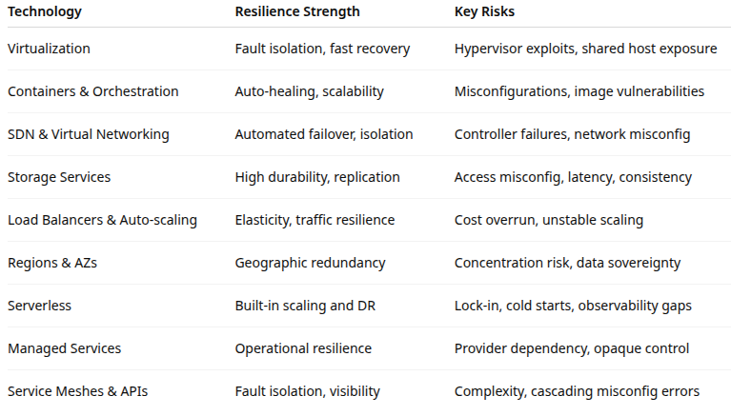
Core Technologies & Concepts

Slide 34
Risk in Cloud Computing
Security and data breach risk
Unauthorized access, data leaks, and breaches due to misconfigurations, weak credentials, or provider vulnerabilities
Shared infrastructure and API-based access increase exposure
Common causes
Misconfigured storage (e.g., public S3 buckets)
Weak identity or access management
Insecure APIs or credentials in code repositories
Poor key management
Multi-tenancy and hypervisor vulnerabilities

Slide 35
Risk in Cloud Computing
Security and data breach risk
Mitigation strategies
Encryption everywhere: encrypt data at rest, in transit, and in use
Identity and Access Management (IAM): enforce least privilege, role-based access, and multi-factor authentication
Continuous monitoring: use SIEM and CSPM (Cloud Security Posture Management) tools
Configuration baselines and automation: enforce security-as-code using tools like Terraform and AWS Config
Regular penetration testing and red teaming
Zero Trust Architecture: verify every connection, even internal ones
Reference example
Capital One’s 2019 AWS breach caused by misconfigured firewall and credential exposure remains a classic case for misconfiguration risk

Slide 36
Risk in Cloud Computing
Compliance and legal risk
Cloud use must align with industry regulations (e.g., GDPR, PCI DSS, HIPAA, GLBA, FedRAMP)
Non-compliance can lead to fines, lawsuits, and reputational harm
Common causes
Data stored outside permitted jurisdictions
Lack of auditable access logs or chain-of-custody
Unverified provider certifications
Cloud provider subcontracting outside visibility
Mitigation strategies
Due diligence on providers: verify certifications (ISO 27001, SOC 2, FedRAMP)
Data sovereignty management: choose region-specific deployments
Shared Responsibility Model: ensure the organization meets its side of compliance
Audit and logging: maintain immutable audit trails
Legal clauses in contracts: ensure rights to data access, audit, and exit
Example
European banks often require “in-region” cloud hosting under the EU’s Digital Operational Resilience Act (DORA)

Slide 37
Risk in Cloud Computing
Operational risk
Failures in day-to-day management, misconfigurations, or outages that affect service delivery
This includes both provider-level incidents and internal mismanagement
Common causes
Provider outages (e.g., AWS region downtime)
Automation scripts gone wrong (IaC mis-deployments)
Insufficient monitoring or alerting
Change management failure
Mitigation strategies
Redundancy: multi-AZ or multi-region deployments
Monitoring and observability: integrate logs, traces, metrics with alerting
Infrastructure as Code (IaC): controlled, versioned deployments
Incident Response Plans: define and test recovery procedures
Chaos testing: proactively simulate failures
Example
AWS outage (Dec 2021) impacted Netflix, Disney+, and Amazon logistics — illustrating concentration risk in provider dependence

Slide 38
Risk in Cloud Computing
Vendor lock-in and dependency risk
Difficulty migrating to another provider due to proprietary services, APIs, or data formats, increasing dependency risk and reducing flexibility
Common causes
Use of provider-specific databases, messaging, or analytics services
Lack of multi-cloud strategy
Proprietary APIs or SDKs
Mitigation strategies
Use open standards and portable architectures (e.g., Kubernetes, containers)
Abstraction layers: deploy middleware that can run across clouds
Data portability: maintain off-cloud backups and export formats
Exit strategies in contracts: define exit timelines, data export rights, and penalties
Example
A financial institution using AWS-native services (Lambda, DynamoDB) made it prohibitively complex to migrate to Azure during vendor review, a real-world lock-in scenario

Slide 39
Risk in Cloud Computing
Concentration and systemic risk
Dependence on a few hyperscalers (AWS, Azure, GCP) introduces systemic fragility.
A single provider outage or policy change can affect multiple industries simultaneously
Common causes
Market dominance by three major CSPs
Shared third-party dependencies (e.g., DNS, CDN)
Geographic or geopolitical dependencies
Mitigation strategies
Multi-cloud deployment: diversify across providers
Hybrid cloud models: keep critical systems on-prem or in private clouds
Resilience exercises: simulate provider outages
Regulatory oversight: especially in critical sectors (financial services, utilities)

Slide 40
Risk in Cloud Computing
Data loss or corruption risk
Loss or corruption of data due to accidental deletion, ransomware, replication errors, or failed recovery
Common causes
Misconfigured lifecycle policies
Application bugs overwriting data
Provider replication errors
Inadequate backup verification
Mitigation strategies
Regular backups and replication testing
Versioning and immutability in object storage (e.g., S3 Object Lock)
Cross-region replication for critical data
Automated backup validation

Slide 41
Risk in Cloud Computing
Identity and access management (IAM) risk
Mismanaged user privileges, API keys, or service roles can lead to privilege escalation or unauthorized access
Common causes
Overly permissive IAM policies (wildcard patterns)
Shared credentials or hardcoded keys
Insufficient monitoring of user behavior
Mitigation strategies
Principle of least privilege and role-based access control
Federated identity and SSO
Key rotation and secret vaulting (e.g., AWS KMS, HashiCorp Vault)
IAM policy audits and anomaly detection

Slide 42
Risk in Cloud Computing
Financial and cost management risk
Uncontrolled cloud consumption can lead to cost overruns, billing surprises, or unprofitable architectures
Common causes
Overprovisioning or idle resources
Poor visibility of cost per application or department
Unused data egress or cross-region traffic costs
Mitigation strategies
FinOps practices: budgeting, monitoring, tagging, and cost allocation
Auto-scaling and serverless usage
Cost alerts and budgets in cloud consoles
Architecture reviews for cost optimization

Slide 43
resilience in Cloud Computing
Dependency on cloud provider availability
Issue: If a region, service, or control plane fails, all dependent workloads go offline
Examples
AWS US-East-1 outages repeatedly affected global services
Microsoft Azure regional authentication failures blocked user logins
Resilience strategies
Multi-AZ and multi-region architectures
Active-active failover across regions
Cross-provider redundancy (multi-cloud)
Automated failback testing using simulated outages

Slide 44
resilience in Cloud Computing
Latency, network, and connectivity risk
Issue: Connectivity between regions or from users to the cloud may degrade due to network congestion or ISP failures
Resilience strategies
Edge caching and CDNs for end-user content
Hybrid deployments for latency-sensitive systems
Redundant connectivity: VPN and Direct Connect links
Traffic routing policies (Anycast, Route53 health checks)

Slide 45
resilience in Cloud Computing
Cascading failures across cloud services
Issue: Cloud applications depend on multiple managed services
If one fails (e.g., storage or identity), dependent services may also fail causing a cascading failure
Resilience strategies
Dependency mapping: identify service interdependencies
Graceful degradation: build apps to continue with limited functionality
Circuit breakers and retry logic in code
Resilience testing (“game days”) to uncover hidden dependencies

Slide 46
resilience in Cloud Computing
Complexity and misconfiguration risk
Issue: Cloud environments have thousands of configuration options
Misconfigurations are one of the top causes of outages and breaches
Resilience strategies
Automation with guardrails: use IaC templates, enforce policy-as-code
Continuous compliance tools (e.g., AWS Config, Azure Policy)
Change management with approvals and version control
Monitoring and alerting for configuration drift

Slide 47
resilience in Cloud Computing
Shared responsibility and misaligned expectations
Issue: Organizations may assume providers handle resilience end-to-end
In reality, providers ensure infrastructure uptime, while customers must ensure application-level continuity
Resilience strategies
Understand shared responsibility model
Design for application-level redundancy
Perform joint DR planning with providers
Define SLAs/SLOs for both provider and internal operations

Slide 48
resilience in Cloud Computing
Recovery and data replication challenges
Issue: While providers replicate data, logical errors (deletions, corruption) can propagate across replicas
Resilience strategies
Immutable backups and air-gapped copies
Cross-region backup separate from production data
Regular restore testing (not just backups)
Version control for datasets and storage buckets

Slide 49
resilience in Cloud Computing
Multi-cloud and hybrid complexity
Issue: Using multiple clouds improves resilience but increases operational complexity, tooling inconsistency, and synchronization challenges
Resilience strategies
Centralized observability and orchestration
Cloud-agnostic platforms (Kubernetes, Terraform, HashiCorp Consul)
Standardized deployment pipelines across environments
Regular failover testing between clouds

Slide 50
resilience in Cloud Computing
Human factors and skill gaps
Issue: Resilience failures often result from misoperation, lack of cloud expertise, or poor incident response readiness
Resilience strategies
Training and certification programs
Incident response drills and game days
DevSecOps culture: shared ownership of resilience
Automated runbooks and playbooks

Slide 51
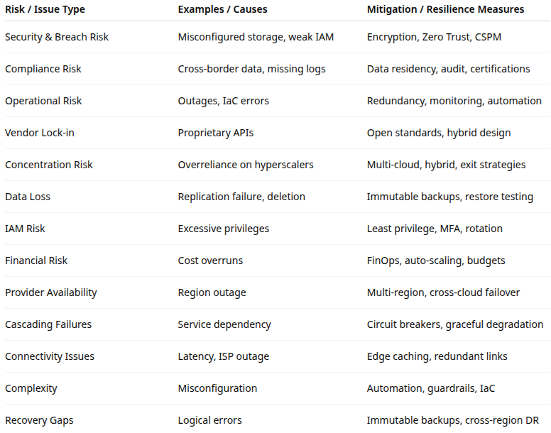
resilience in Cloud Computing

Slide 52

Q&A and open discussion
Notes:
Now is the time to engage in an interactive Q&A session where you can ask questions, share insights, and clarify any doubts about the topics we have covered so far.
This open discussion is designed to ensure that every participant has the opportunity to voice their thoughts and learn from the collective experience of the group.
Your questions and comments are valuable as they help us identify areas that may need further explanation and enable us to tailor future sessions to your needs.
We encourage you to speak up and contribute to the dialogue, as this interaction is one of the key components of our interactive learning approach.
As the session progresses, take note of any questions or ideas that you would like to revisit, and feel free to share your perspectives with the class.

